Slide 1
Grant Monitor Demo Day
Daron Adams, Ken Schnarrs, Alex Iliev, Chase Rumfelt

Slide 2
Wireframe Designs

Slide 3
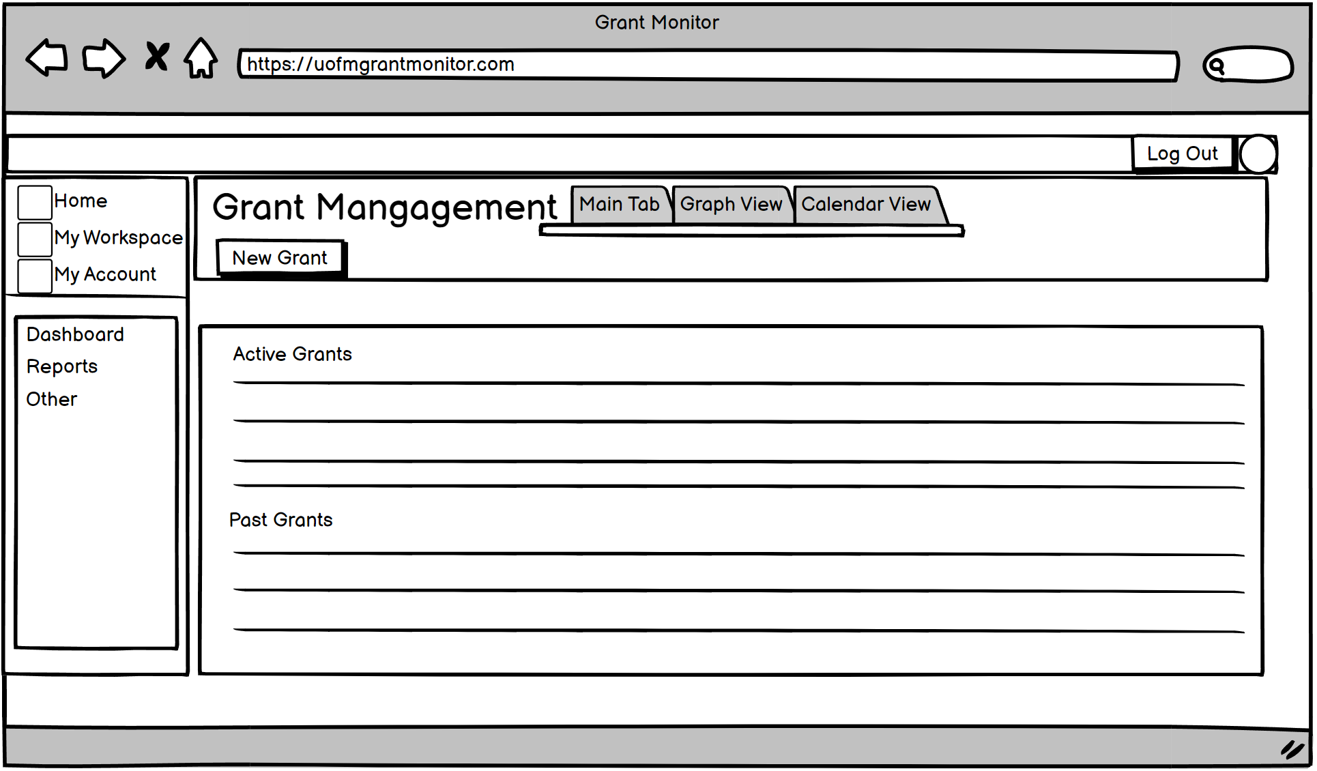
Live Demo

Slide 4
Basic Frontend

Slide 5

Made with React

Slide 6
Made with React

Slide 7
Basic Backend

Slide 8
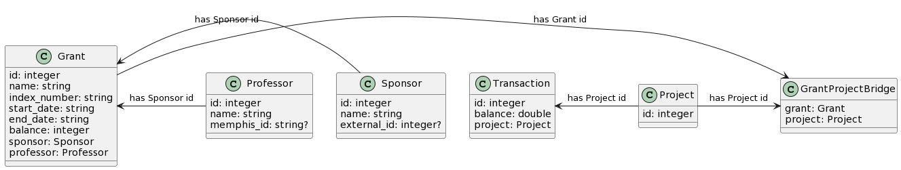
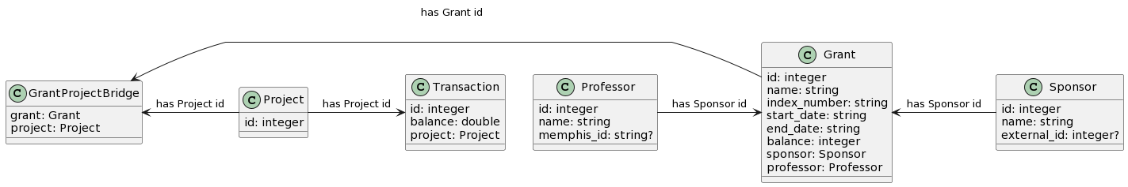
Database Rough Sketch

Slide 9
GitHub

Slide 10
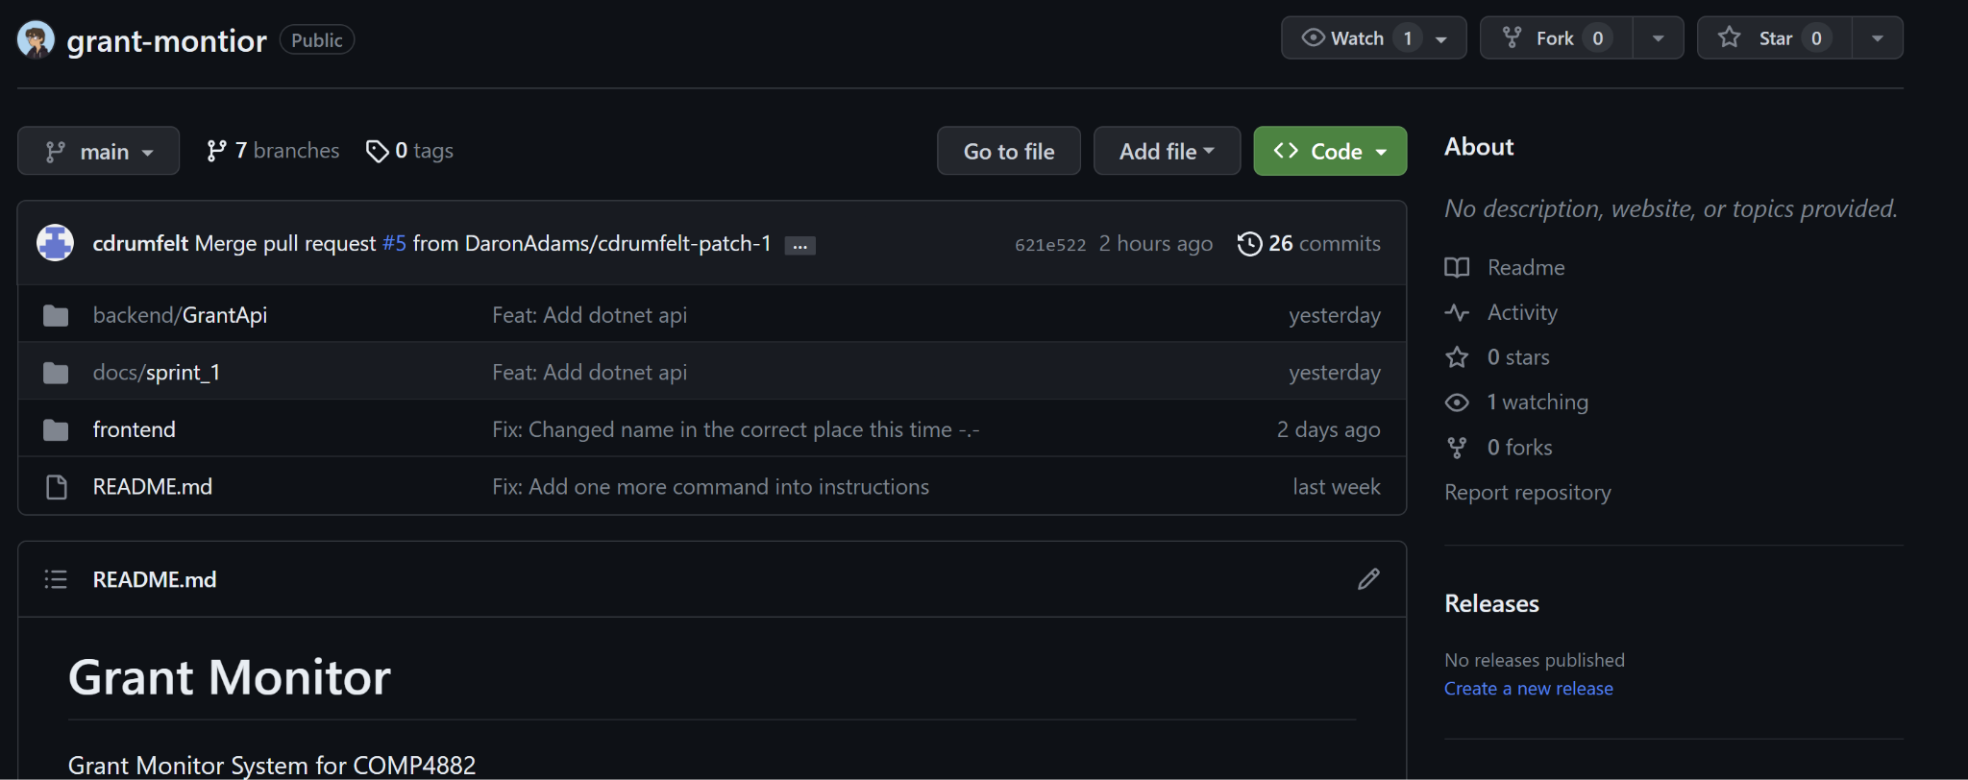
ANOTHER live demo

